Slide 1

IST 402 Network Security TLS & Certificates LM3
Joe Oakes
Penn State Abington

Slide 2


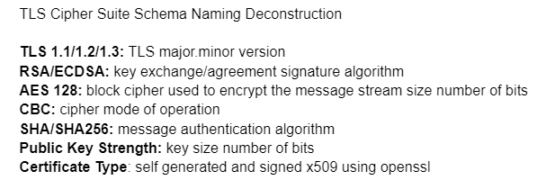
TLS Transport Layer Security
Transport Layer Security methods needed to perform
Key Exchange share a password
Encryption Ciphers
Block Chaining
Hashing check Integrity
Random number generation
Encoding
Certificates
Work with protocols
Work with handshaking

Slide 3
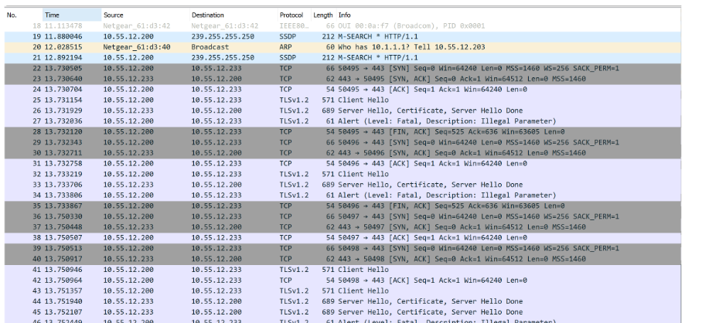
TLS: Why use it: Asymmetric Encryption
Encryption: the process of hiding the messages sent from one computer to another by changing the content to be unreadable
The public key is public to everyone. The private key is uniquely associated with the owner and is not made public.
Notice the wireshark capture
Client
Message using TLS 1.2
Server
Hacker using a Packet Sniffer
Cannot decipher the payload

Slide 4
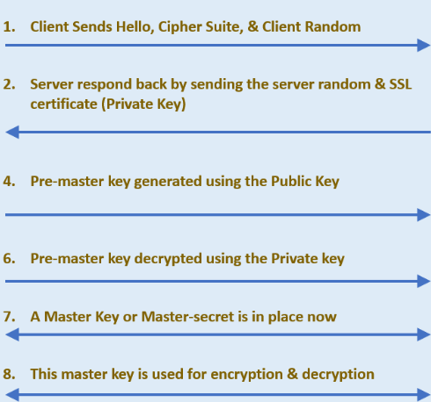

TLS: Client -Server Handshaking
Notice there is handshaking that takes place between the client and the server with TLS

Slide 5
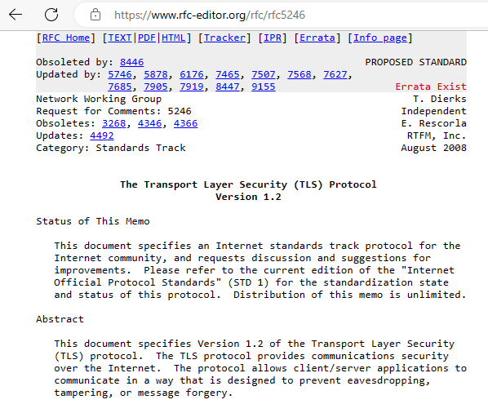
TLS: RFC Request for Comments
A secure way to send the message is currently using TLS 1.3
See if you can find the RFC # for TLS 1.3
See RFC 5246 for TLS 1.2 https://tools.ietf.org/html/rfc5246.
SSL versions 2, 3 and TLS 1.0 have been deprecated

Slide 6
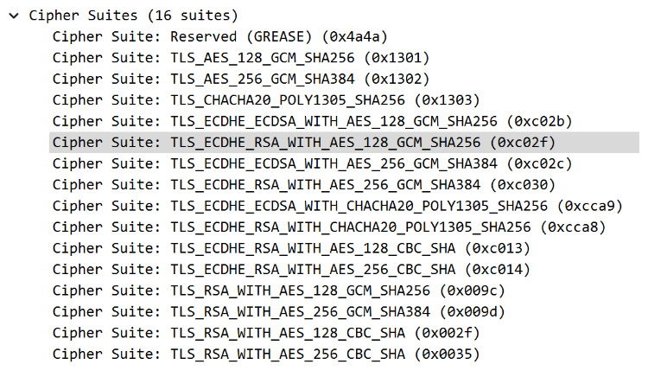
TLS: Public/Private Key Exchange
Encryption
The Client and Server need to agree on how to encrypt the message payload
Notice the difference Cipher Suites
TLS_AES_128_GCM_SHA256
AES Cipher 128 bit, Galois/Counter Mode for symmetric-key cryptographic block ciphers, SHA256 Hash 256
Client
Message
Key | Cipher | Hash
RSA | RC4 | HMAC-MD5
Diffie-Hellman | Triple DES | HMAC-SHA
DSA | AES

Slide 7
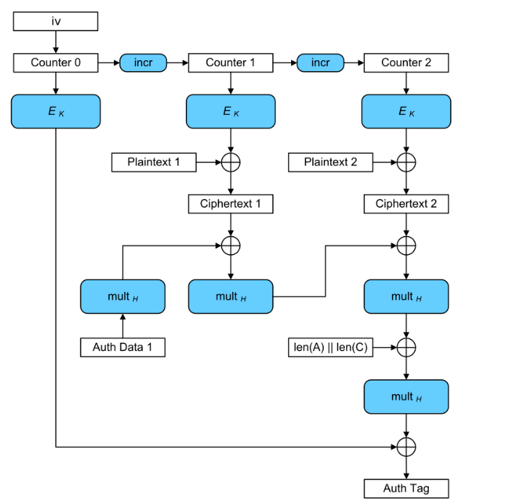
TLS: GCM Galois/Counter Mode
Encryption
Galois/Counter Mode for symmetric-key cryptographic block ciphers

Slide 8
TLS: Public/Private Key Exchange
Encryption
Computer agree how to encrypt the message payload
Server sends certificate (details about itself)
Server decrypts the client's message using the private key
Client and Server generate secret
Client and Server start encrypting session
Client
Server
Message
Key Type | Cipher Type | Hash Type
RSA | RC4 | HMAC-SHA128
Diffie-Hellman | Triple DES | HMAC-SHA256
DSA | AES
Key Type | Cipher Type | Hash
RSA | RC4 | HMAC-SHA128
Diffie-Hellman | Triple DES | HMAC-SHA256
DSA | AES

Slide 9


TLS: RSA Algorithm
RSA algorithm creates a pair of commutative keys one key encrypts and one key decrypts with the other
Notice they can work in both directions
You keep one of those keys to yourself and never share it and give the other key out freely.
Key Type | Cipher Type | Hash Type
RSA | RC4 | HMAC-SHA128
Diffie-Hellman | Triple DES | HMAC-SHA256
DSA | AES

Slide 10
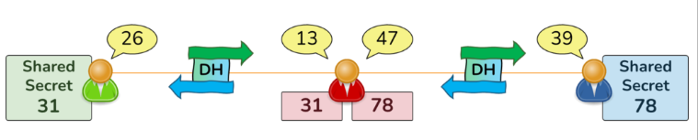
TLS: Diffie-Hellman Algorithm
Diffie-Hellman can only assure that the other side has the same secret as you.
Diffie-Hellman cannot provide any assurance as to who the other side is.
Someone can set themselves up in the middle between the parties – Man in the middle attack they can perform the DH exchange on behalf of the other party
The Red user is (maliciously) proxying the Diffie-Hellman exchange and performing DH on both sides with the Green and Blue users.
The Green and Blue users now have different resulting Shared Secrets (31 and 78), and the Red user knows them both!

Slide 11
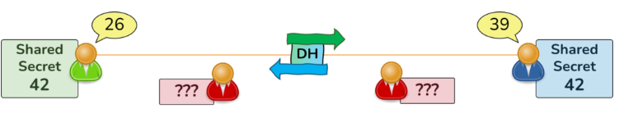
TLS: Diffie-Hellman Algorithm
Symmetric encryption uses identical keys for Encryption and Decryption.
The result of the Diffie-Hellman Key Exchange is both parties have an identical Shared Secret.
The shared secret itself should not be used directly as a Symmetric Key. Instead, it should be used as a seed value, from which to derive any amount of required symmetric keys.
The Green and Blue user exchange public values of 26 and 39, and use a private value (not displayed) to create the shared secret of 42.
Diffie-Hellman cannot provide any assurance as to who the other side is.
Key Type | Cipher Type | Hash Type
RSA | RC4 | HMAC-SHA128
Diffie-Hellman | Triple DES | HMAC-SHA256
DSA | AES

Slide 12
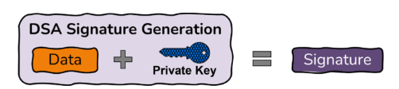
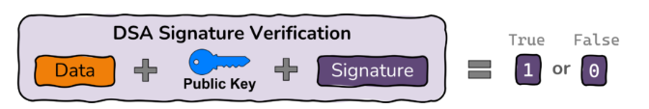
TLS: DSA is used for Signatures
Digital Signature Algorithm
Keys are not exchanged, there are two operations: signature generation and signature verification
DSA Signature Generation operation takes as input Data and a Private Key, and produces as output a Signature.
DSA Signature Verification operation takes as take as input Data, a Public Key (correlating to the Private Key which created the Signature), and the Signature.
If the Signature is valid, this proves the Integrity and Authentication of the Data
Key Type | Cipher Type | Hash Type
RSA | RC4 | HMAC-SHA128
Diffie-Hellman | Triple DES | HMAC-SHA256
DSA | AES

Slide 13
TLS: Parts of the Public/Private Key Exchange
The Key type RSA (Rivest–Shamir–Adleman) the user of RSA creates and then publishes a public key based on two large prime numbers, along with an auxiliary value. The prime numbers must be kept secret. Anyone can use the public key to encrypt a message and only someone with knowledge of the prime numbers can decode the message
The Cipher is the encryption method: AES Advances Encryption Standard which is a block type of cipher (the message is packaged in blocks of data)
Hash functions are used for assuring the integrity of the transmitted data – if you tamper with the message the Hash signature would be different
HMAC is a hashed message authentication
Key Type | Cipher Type | Hash Type
RSA | RC4 | HMAC-SHA128
Diffie-Hellman | Triple DES | HMAC-SHA256
DSA | AES

Slide 14
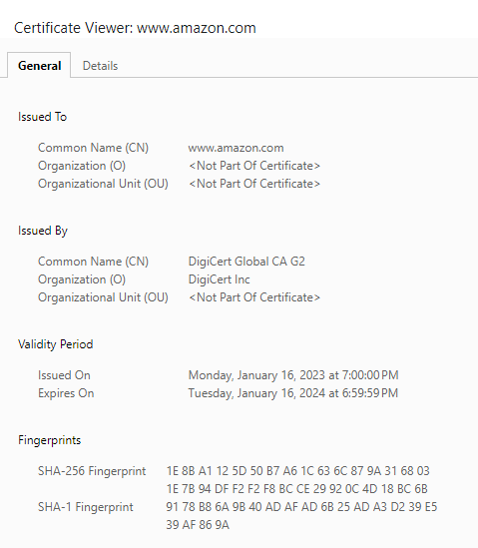
TLS: Public/Private Key Exchange
Encryption
Computer agree in how to encrypt
Server sends certificate (details about itself)
Client starts encrypting
Server starts encrypting
Client
Server’s Certificate
Serial: 234234234
Issuer: Verisign
Valid: From-to
Subject: Site, Company , Address
Public Key
Server

Slide 15
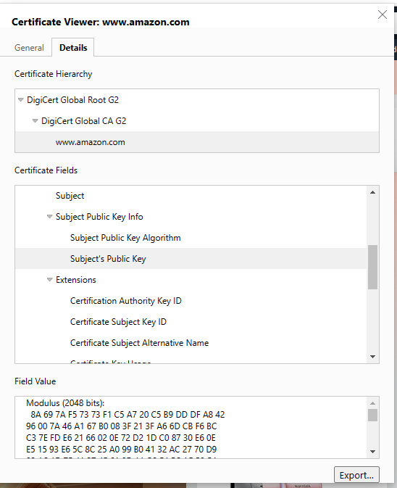
TLS: Public/Private Key Exchange
Encryption
Computer agree in how to encrypt
Server sends certificate (details about itself)
Client uses the public key to generate the pre-master secret and encrypt the response message to the server
Server decrypts the client's message using the private key
Client and Server generate secret
Client and Server start encrypting session
Modulus (2048 bits): 8A 69 7A F5 73 73 F1 C5 A7 20 C5 B9 DD DF A8 42 96 00 7A 46 A1 67 B0 08 3F 21 3F A6 6D CB F6 BC C3 7E FD E6 21 66 02 0E 72 D2 1D C0 87 30 E6 0E E5 15 93 E6 5C 8C 25 A0 99 B0 41 32 AC 27 70 D9 02 1C 1D 7E 41 37 4F 61 0D 1A B9 E4 EC AF 58 54 33 5A C5 AD EA C3 2E 90 79 E0 DA 2B D0 D3 6E 19 0D C9 12 E6 B6 30 26 64 8C E3 EF 80 FF 46 DC 9E 13 05 6B 17 17 1A DC 1A AF DD 13 5B 67 64 C6 C6 69 3B 64 C7 38 FB CB 10 4A AF 40 3B 36 F6 72 AA 7F CB AE A0 2B 31 A6 A2 50 40 D8 47 B4 B9 4C 76 37 26 4D 3A B2 8C 98 5E 36 C1 CD 1B 97 B6 C5 C4 D4 80 ED AF 55 3F 51 05 BF 96 6A DF 16 12 93 80 01 21 AA DA 6A 01 0B 1A BD 3E EC B5 31 B0 E8 61 FA 3F 48 9F 7B 7E C4 75 DC C0 25 BF 00 B7 0B 5C E6 56 2A D4 62 4F 3A 0A 89 85 FC AF BC B9 17 07 43 3F AB 95 EE 54 1B 3A D0 45 89 AD 3F B9 73 9D Public Exponent (17 bits): 01 00 01

Slide 16
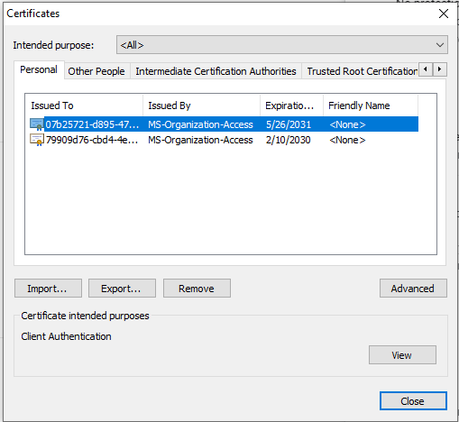
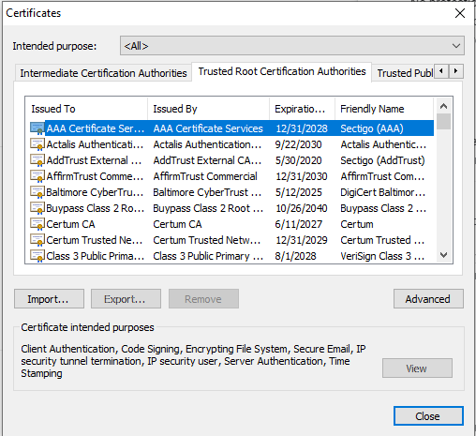
TLS: Public/Private Key Exchange
Browser -> Settings -> Privacy and security -> Manage device certificates

Slide 17
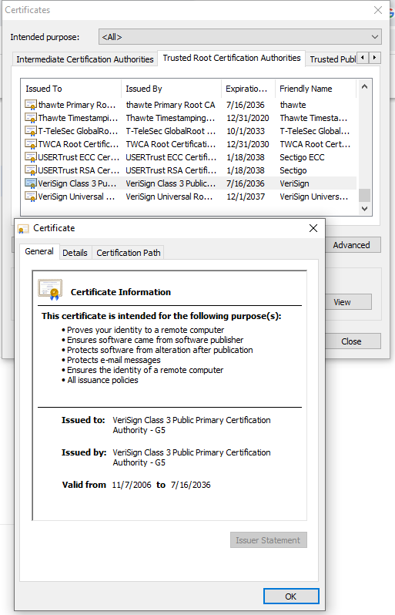
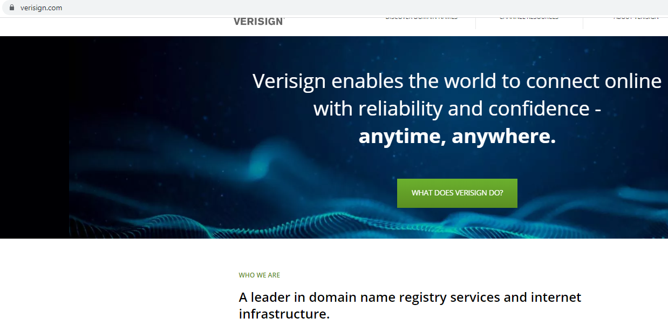
TLS: Public/Private Key Exchange
Certificates Authorities

Slide 18
TLS: Public/Private Key Exchange
Encryption
Computer agree in how to encrypt
Server sends certificate (details about itself)
Client uses the public key to generate the pre-master secret and encrypt the response message to the server
Server decrypts the client's message using the private key
Client and Server generate secret
Client and Server start encrypting session
Client
Client uses public key to generate the pre-master secret and encrypts the response message to the server
Server

Slide 19
TLS: Public/Private Key Exchange
Encryption
Computer agree in how to encrypt
Server sends certificate (details about itself)
Client uses the public key to generate the pre-master secret and encrypt the response message to the server
Server decrypts the client's message using the private key
Client and Server generate secret
Client and Server start encrypting session
Client
Client Key Exchange
Both computers calculate a master secret code
Use the Cipher spec
The client asks the server to encrypt
Server

Slide 20
TLS: Public/Private Key Exchange
Encryption
Computer agree in how to encrypt
Server sends certificate (details about itself)
Client uses the public key to generate the pre-master secret and encrypt the response message to the server
Server decrypts the client's message using the private key
Client and Server generate secret
Client and Server start encrypting session
Client
Server and Client starts encrypting
Messages are hidden
33oir03u4r0ijfk;;e
Server

Slide 21
TLS: Identification
Identification: To identify the computer you are working with is the one you trust
Company asks CA Certificate Authority for a certificate
CA (for example Verisign) verifies, creates certificate and signs it
Certificate installed on the server
Browser issued with root certificates
Browser trusts correctly signed certs

Slide 22
TLS: Identification
Identification: To identify the computer you are working with is the one you trust
Company asks CA Certificate Authority for a certificate
Company provides the following to the CA
The web server
The company name
Where the company is located

Slide 23
TLS: Identification
Identification: To identify the computer you are working with is the one you trust
Company asks CA Certificate Authority for a certificate
CA (for example Verisign) verifies, creates certificate and signs it
Version
Serial Number
Algorithm ID
Issuer
Valid from –to
Company details
Public key
Signature – created by condensing all details into a hash number (then encrypted with the private key) The public and private key are a pair used to encrypt and decrypt. So anyone who has the public key can decrypt to verify it is correct.

Slide 24
TLS: Identification
Identification: To identify the computer you are working with is the one you trust
Company asks CA Certificate Authority for a certificate
CA (for example Verisign) verifies, creates certificate and signs it
Certificate installed on the server
The CA gives it back to the company
They install the certificate on the server – apache, IIS web server
Used on the handshaking process

Slide 25
TLS: Identification
Identification: To identify the computer you are working with is the one you trust
Company asks CA Certificate Authority for a certificate
CA (for example Verisign) verifies, creates certificate and signs it
Certificate installed on the server
Browser issued with root certificates
Browser trusts correctly signed certs

Slide 26
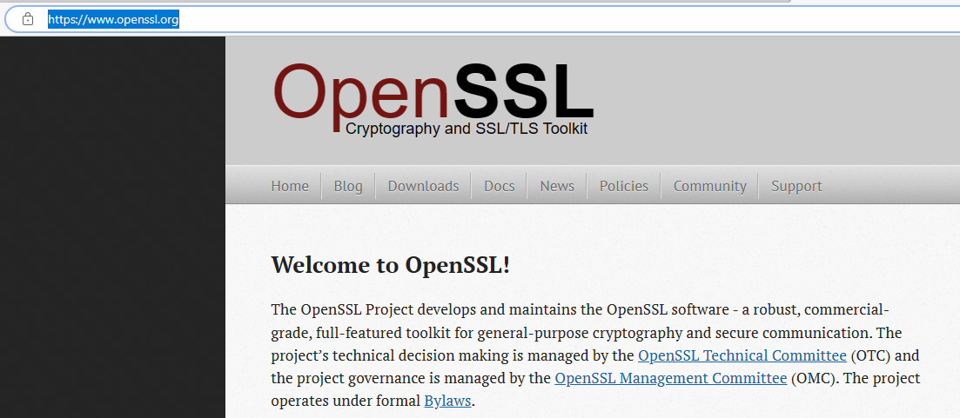
TLS: Server Cert & Key
/index.html (openssl.org)
Download at Binaries - OpenSSLWiki
Download OpenSSL works on Windows, Apple Mac and Linux

Slide 27
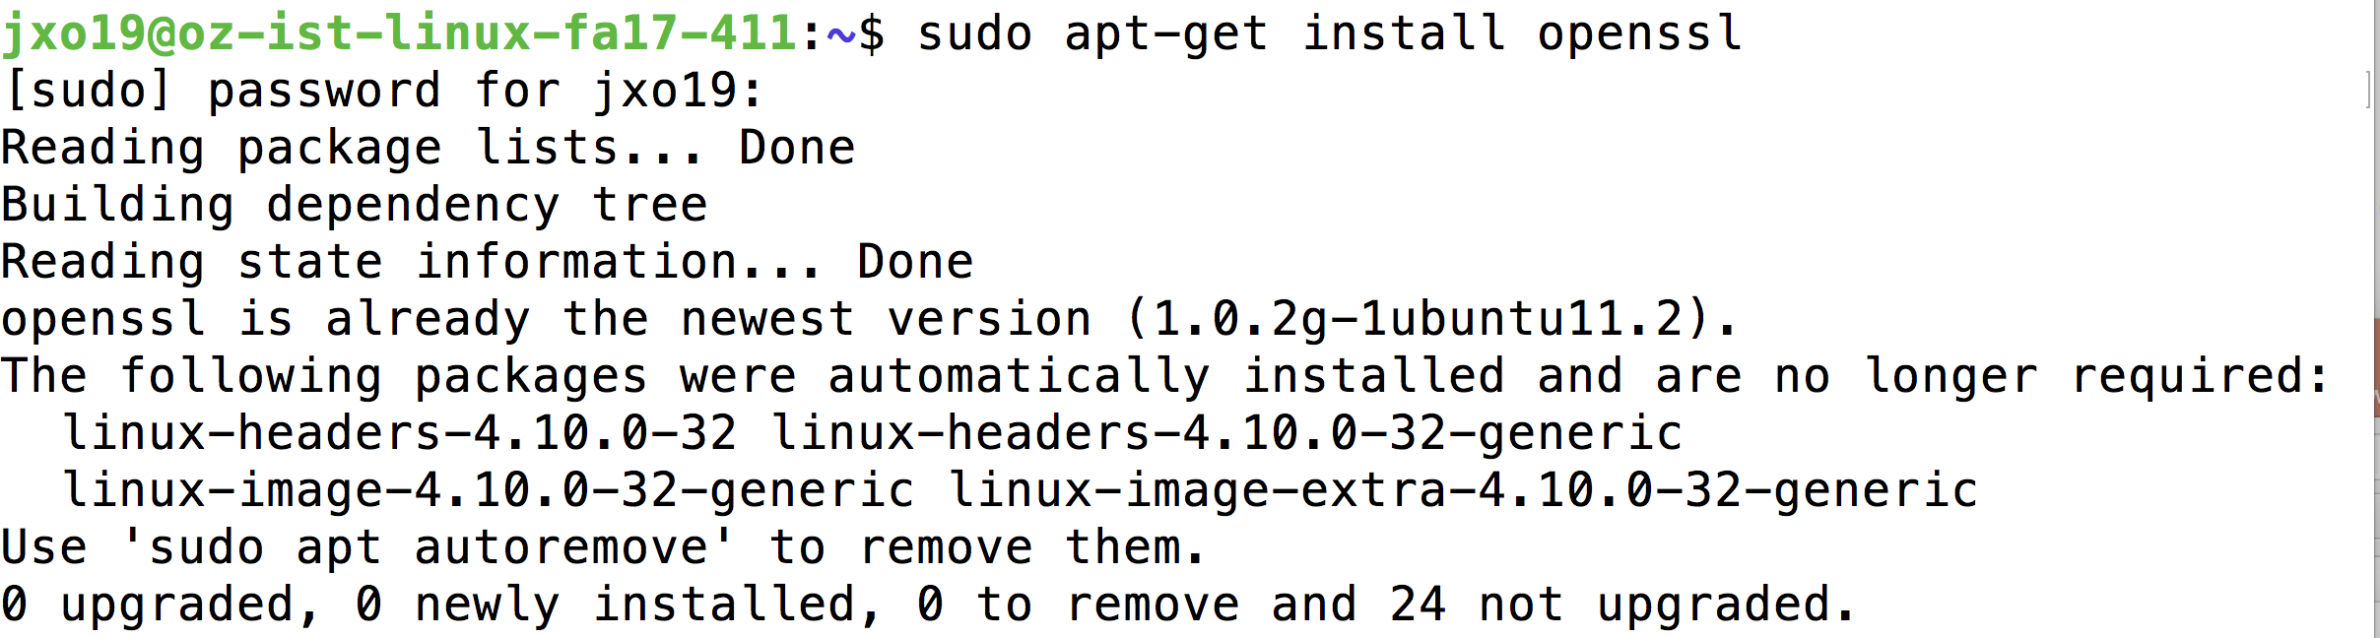
TLS: OpenSSL Linux
Install the openssl

Slide 28
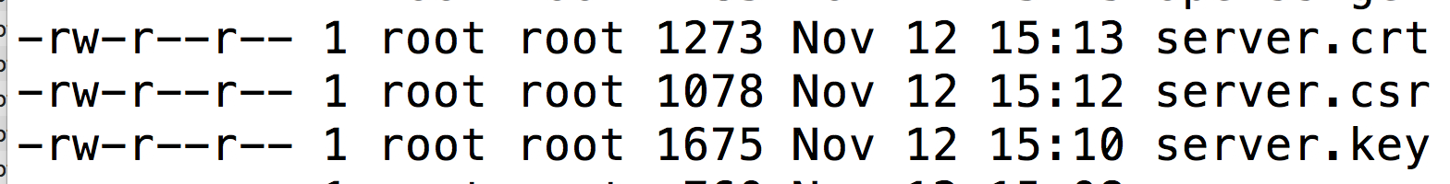
TLS: Server Cert & Key Linux
Make sure openssl is installed – it is installed on the Linux system
$ sudo apt-get install openssl
Generate private key and certificate signing request
$ openssl genrsa -des3 -out server.orig.key 2048
Generate the Server private key
$ openssl rsa -in server.orig.key -out server.key
Generate the certificate signing request – leave the password empty
$ openssl req -new -key server.key -out server.csr
Generate the site certificate
$ openssl x509 -req -days 365 -in server.csr -signkey server.key -out server.crt

Slide 29
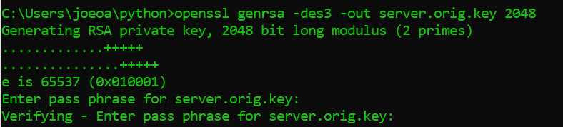
TLS: Server Cert & Key Windows
Step 1: Generate private key and certificate signing request
openssl genrsa -des3 -out server.orig.key 2048

Slide 30

TLS: Server Cert & Key Windows
Step 2: Generate the Server private key
openssl rsa -in server.orig.key -out server.key

Slide 31
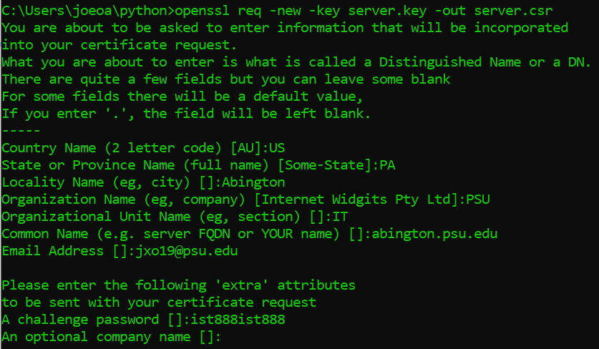
TLS: Server Cert & Key Windows
Step 3: Generate the certificate signing request
openssl req -new -key server.key -out server.csr

Slide 32
TLS: Server Cert & Key Windows
Step 4: Generate the site certificate
openssl x509 -req -days 365 -in server.csr -signkey server.key -out server.crt

Slide 33
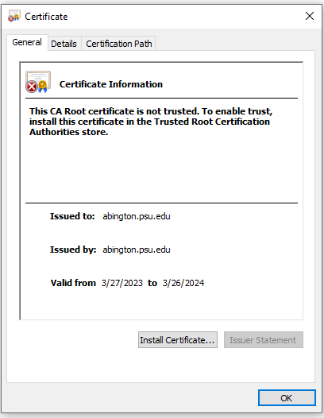
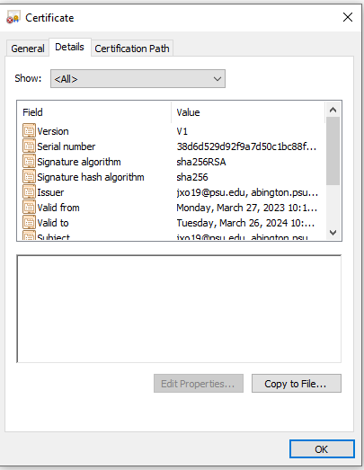
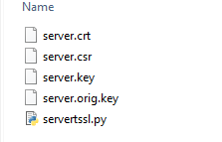
TLS: Server Cert & Key Windows
Notice the following files and you can open the server cert file .crt

Slide 34
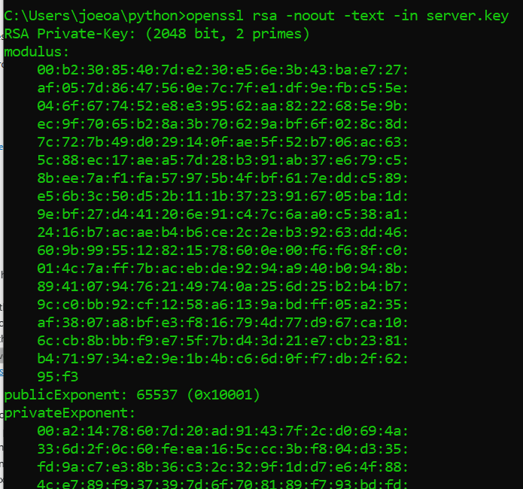
TLS: Server Cert & Key Windows
openssl rsa -noout -text -in server.key

Slide 35
TLS: Server Code for using TLS with networking sockets
# serverssl.py
import socket, ssl
try:
context = ssl.create_default_context(ssl.Purpose.CLIENT_AUTH)
context.verify_mode = ssl.CERT_REQUIRED
context.load_cert_chain(certfile='server.crt', keyfile='server.key')
print("create an INET, STREAMing socket")
s = socket.socket(socket.AF_INET, socket.SOCK_STREAM)
ssl_sock = context.wrap_socket(s)
print("bind the socket to a public host, and a well-known port 8080")
ssl_sock.bind(('localhost', 8080))
ssl_sock.listen(5)
while True:
print("accept SSL connections from outside")
(clientsocket, address) =ssl_sock.accept()
except Exception as e:
print(e)

Slide 36
TLS: on Linux: Server Code for using TLS with networking sockets
# serverssl.py SSL uses port 443 by default but for this example I used 8080
import socket, ssl
try:
print("create an INET, STREAMing socket using SSL")
s = socket.socket(socket.AF_INET, socket.SOCK_STREAM)
ssl_sock = ssl.wrap_socket(s,
server_side=True,
certfile="server.crt",
keyfile="server.key")
print("bind the socket to a public host, and a well-known port 8080")
ssl_sock.bind(('localhost', 8080))
ssl_sock.listen(5)
print("ciphers: " + str(ssl_sock.cipher()))
while True:
print("accept connections from outside")
(clientsocket, address) = ssl_sock.accept()
except Exception as e:
print(e)
ssl_sock.close()

Slide 37
TLS:Client Code for using TLS with networking sockets
# clientssl.py SSL uses 443 port but this example I used 8080
import socket, ssl
try:
print("Client connecting on port 8080 using SSL")
s = socket.socket(socket.AF_INET, socket.SOCK_STREAM)
ssl_sock = ssl.wrap_socket(s,
ca_certs="server.crt",
cert_reqs=ssl.CERT_REQUIRED)
ssl_sock.connect(('localhost', 8080))
except Exception as e:
print(e)
print(ssl_sock.cipher())
ssl_sock.close()

Slide 38
Password Exchange: Works Cited
RSA, Diffie-Hellman, DSA: the pillars of asymmetric cryptography – Practical Networking .net

